Slide 1
Lecture 1.1 Introduction to computer components
School of Computing and Information Technology
Bhavya.K R
bhavya.kr@reva.edu.in
Year: 2021- 2022

Slide 2
Computer System
A computer is an electronic device, under the control of instructions stored in its memory that can accept data (input), process the data according to specified rules(Program) on processor & produces information (output), and store the information for future use
Data vs Information
Data are raw numbers or other findings which, by themselves, are of limited value.
Information is data that has been converted into a meaningful and useful context.
Computers are being used extensively nowadays in everyday life/every field
In the form of laptop, desktop, smartphone, gadgets etc.

Slide 3
Computer System
Advantages of computer
Speed
Accuracy
Huge storage
Versatility
Tirelessness
Disadvantages of computer
Data security issue
Computer crimes
Health risk
Bad impact on environment if not properly disposed off

Slide 4
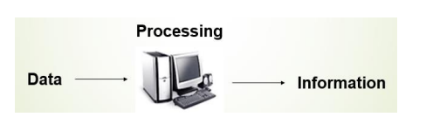
Computer System
Any digital computer performs five functions in gross term.
Take data as input
Stores data/instructions
Process those stored data
Generate the output
Control all above steps

Slide 5
Computer System
Computing
The use of a computer to process data or perform calculations or the act of calculating or reckoning through computer is known as computing.

Slide 6
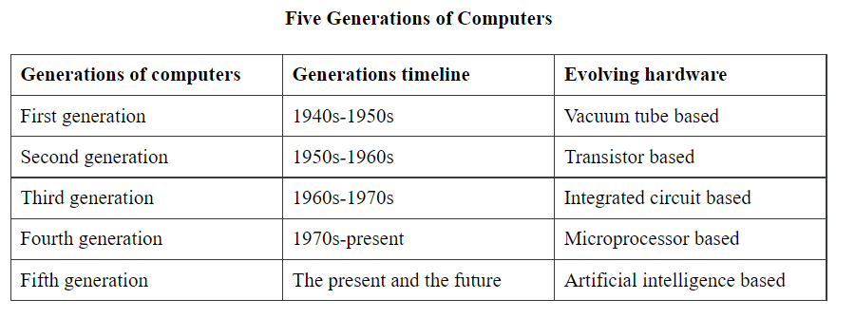
Computer System
Generations of a computer
The evolution of computer technology is often divided into five generations.

Slide 7
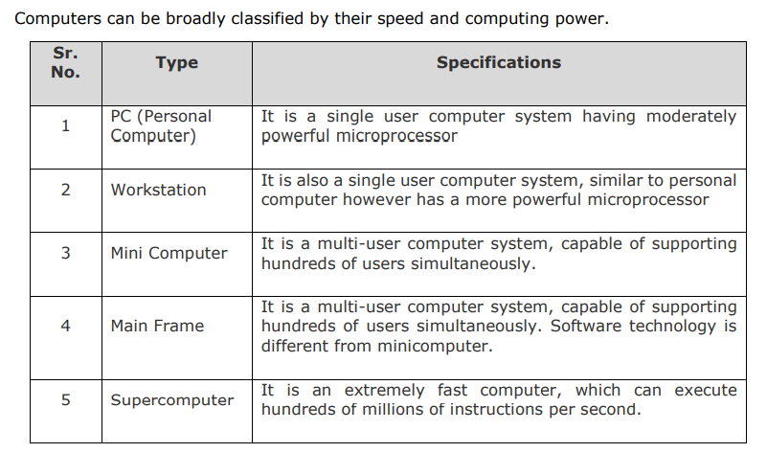
Types of computer

Slide 8
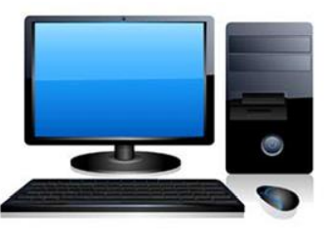
Types of computer
PC (Personal Computer)
A PC can be defined as a small, relatively inexpensive computer designed for an individual user.
PCs are based on the microprocessor technology that enables manufacturers to put an entire CPU on one chip.
Businesses use personal computers for word processing, accounting, desktop publishing, and for running spreadsheet and database management applications.
At home, the most popular use for personal computers is playing games and surfing the Internet.

Slide 9
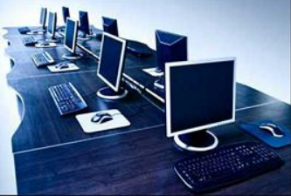
Types of computer
Workstation is a computer used for engineering applications (CAD/CAM), desktop publishing, software development, and other such types of applications which require a moderate amount of computing power and relatively high quality graphics capabilities.
Workstations generally come with a large, high-resolution graphics screen, large amount of RAM, inbuilt network support, and a graphical user interface. Most workstations also have mass storage device such as a disk drive.
Common operating systems for workstations are UNIX and Windows NT. Like PC, workstations are also single-user computers like PC but are typically linked together to form a local-area network, although they can also be used as stand-alone systems.

Slide 10
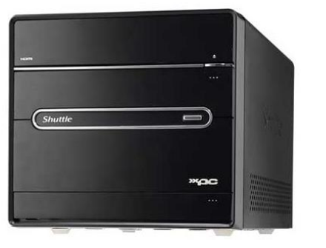
Types of computer
Minicomputer
It is a midsize multi-processing system capable of supporting up to 250 users simultaneously.

Slide 11
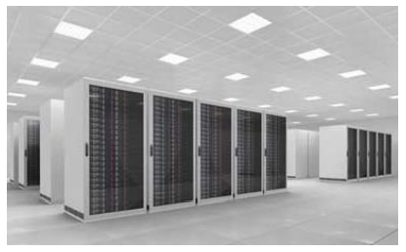
Types of computer
Mainframe
Mainframe is very large in size and is an expensive computer capable of supporting hundreds or even thousands of users simultaneously.
Mainframe executes many programs concurrently and supports many simultaneous execution of programs.

Slide 12
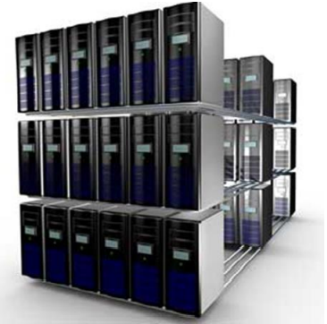
Types of computer
Super Computer
Supercomputers are one of the fastest computers currently available.
Supercomputers are very expensive and are employed for specialized applications that require immense amount of mathematical calculations (number crunching).

Slide 13
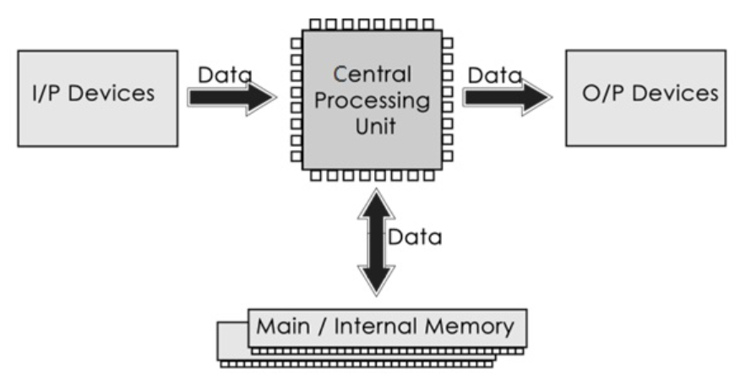
Components of computer
Computer systems consist of three components as shown in below image: Central Processing Unit, Input devices and Output devices. Input devices provide data input to processor, which processes data and generates useful information that’s displayed to the user through output devices. This is stored in computer’s memory.

Slide 14
Components of computer
Input Unit
A device through which data and programs from the outside world enter the computer system.
Output unit
A device through which results stored in the computer memory are made available outside the computer system.

Slide 15
Components of computer
Central processing unit – Comprises three parts
Arithmetic/Logic Unit
Performs basic arithmetic operations such as addition and subtraction Performs logical operations such as AND, OR, and NOT. Most modern ALUs have a small amount of special storage units called registers that can be accessed faster than main memory.
Control unit
It organizes the computer to work computer as single unit & generates control signals for various devices regarding read/write or execute operation
Memory unit
This is unit in which data and instructions given to computer as well as results given by computer are stored. Unit of memory is "Byte". 1 Byte = 8 Bits

Slide 16
Components of computer
Key Terms:
RAM and ROM
Random Access Memory (RAM)
Memory in which each location can be accessed and changed
Read Only Memory (ROM)
Memory in which each location can be accessed but not changed RAM is volatile, ROM is not

Slide 17
Components of computer
Difference | RAM | ROM
Data retention | RAM is a volatile memory which could store the data as long as the power is supplied. | ROM is a non-volatile memory which could retain the data even when power is turned off.
Working type | Data stored in RAM can be retrieved and altered. | Data stored in ROM can only be read.
Use | Used to store the data that has to be currently processed by CPU temporarily. | It stores the instructions required during bootstrap of the computer.
Speed | It is a high-speed memory. | It is much slower than the RAM.
CPU Interaction | The CPU can access the data stored on it. | The CPU can not access the data stored on it unless the data is stored in RAM.
Size and Capacity | Large size with higher capacity. | Small size with less capacity.
Used as/in | CPU Cache, Primary memory. | Firmware, Micro-controllers
Accessibility | The data stored is easily accessible | The data stored is not as easily accessible as in RAM
Cost | Costlier | cheaper than RAM.

Slide 18
Input devices
Input devices can send data or information to a computer or another device.
Keyboard: It is an input device which sends data in to the computer. The data send depends on the key pressed by the user.
Mouse: A mouse is a small handheld input device which controls a cursor in a graphical user interface. It can move and select text, files, folders etc. on our computer according to the user input.
Scanner: Scanner optically reads and document, file or image and then changes it into digital signal and sends to the computer.
OMR: optical mark recognition/ reader, is used to read marks on a document and send them to computer.
OCR: OCR stands for optical character Recognition, is an input device which reads printed text and sends that to computer.
MICR: Magnetic Ink Character Reader is an input device which generally finds application is banks to process cheques.Microphone: it receives audio generated by some input source and sends the same to a computer.
Webcam: it sends the captured images to a computer.
Graphics Tablets: This input device is used to draw using hand.
Trackballs: an upside down mouse ,encased within a socket. Is a cursor control device.
Barcode reader: It is used to read the barcode of various items and feed the same to computer.
Gamepad: Also known as joy pad is the input controller for video games.
Joystick: these input devices are used to control video games.

Slide 19
output devices
A device that can receive data from computer or another device and create output with that data is called output device.
Examples of various output devices are as :
Monitor: A monitor is an output device that is responsible for receiving data from a computer and displaying that information as text or images for users to see.
Speakers: Receives sound signal from a computer and then plays that sound signal and thus we hear songs or music or any other audio.
Projector: Gets data from a computer and displays or projects the same information onto a screen or a wall. Projector cannot directly accept data from a user and send that data to another device

Slide 20
Both input and output devices
An input/output device is capable of receiving data from users or another devices and also sending data to another devices or computers. That means a devices which can be used as both input device and output device are called Input / Output (I/O) devices. Some examples of input/output devices are as:
USB drive: Also known as pen drive or flash stick works as both input device to computer and as an output device. USB drives receive or save data from a computer as an input and it can also send data to a computer or another device. Facsimile: Facsimile or FAX machine has a scanner which is an input device and a small printer to provide output.
Modems: It is used to transmit and receive data from one computer to another computer or other devices using telephone lines
CD-RW drives and DVD-RW drives: Receives data from a computer as input to copy onto and save into writable CD or DVD. We also use CDs or DVDs to transfer data to a computer.
Touch Screen: Touch screen is both input and output device. By touching the screen input is provided and being a screen, it is used as an output device.
Headsets: Headset consists of speaker as an output device and microphone

Slide 21

DISCUSSION
5 MINUTES
Discussion or queries

